Slide 1

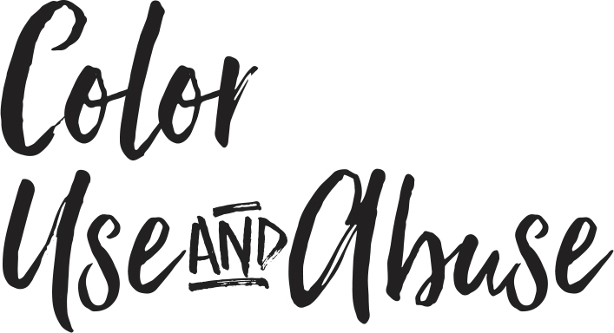

Slide 2
Use Color Purposefully
Use Color to:
Unify/Separate Content
Emphasize/De-emphasize Content
Direct readers where to look first
Add personality to content

Slide 3
Designing with Color
Use Color in:
Primary Headlines
Drop Caps
Caption Overlays
Rule Lines
Info-graphics
Backgrounds

Slide 4
Color Strategies
Echoing color from photos
Theme/concept driven
Choose 2 cool and 1 warm or
2 warm and 1 cool colors

Slide 5
Color Don’ts
Color Abuses:
Body copy in color
Painting the page with color
Color overpowering the photos
Lack of a strategy
Technically weak color images

Slide 6
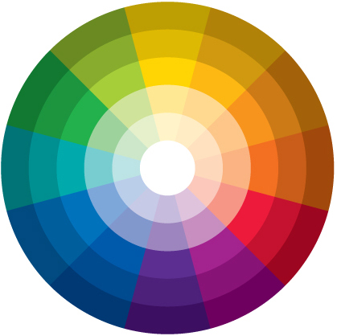
Know your color wheel
Dark, medium and light values of a single color provide contrast
THE COLOR WHEEL

Slide 7
Know your color wheel
Adjacent colors create pleasing, low-contrast harmony
THE COLOR WHEEL // Analogous

Slide 8
Know your color wheel
Opposite colors create high-contrast intensity
THE COLOR WHEEL // Complementary

Slide 9
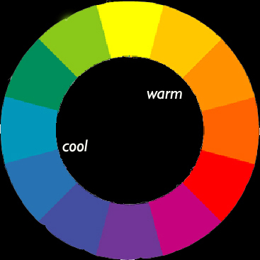
Know your color wheel
Cool colors (with a blue base) tend to recede.
Warm colors (in the red/orange families are perceived as advancing.
THE COLOR WHEEL // Cool vs. warm colors

Slide 10
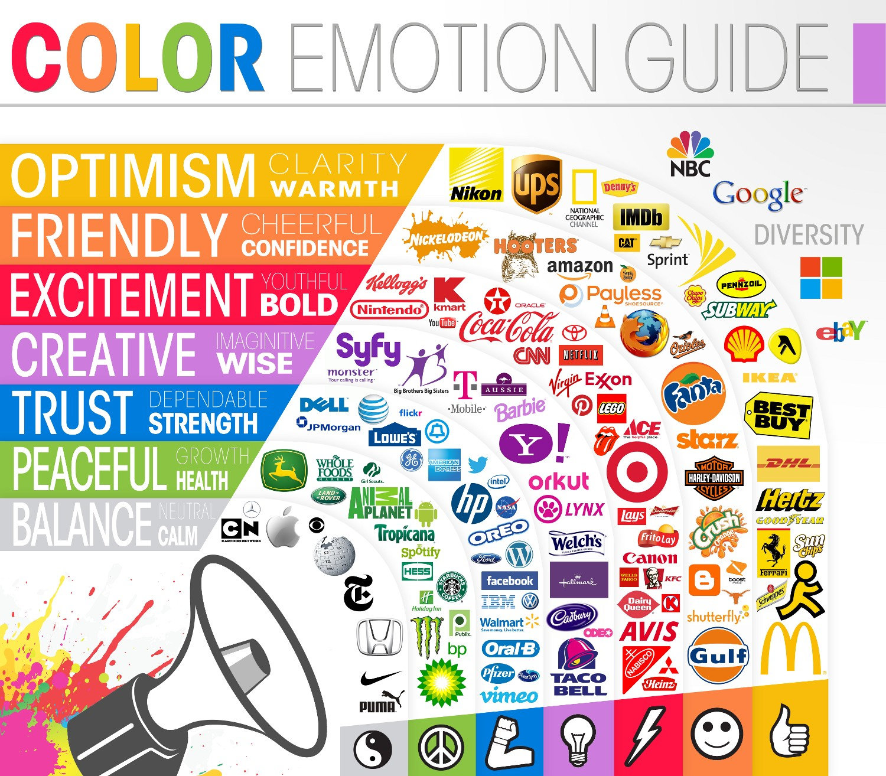
Use color psychology

Slide 11
Use color psychology
RED
is the most dramatic, intense and emotional color attracting the eye no matter where it appears. A very immediate color, red can appear closer than it is. Lighter hues in the red spectrum elicit joy and sensitivity, while deeper hues can translate to passion and anger. Physiologically, it is known to increase energy and appetite.

Slide 12
Use color psychology
ORANGE
This combo of yellow and red is energetic, exciting and warm. It is an attention getting color, as is red, but in a more welcoming and friendly way. It also possessed a spiritual dimension associated with its connection to fire.

Slide 13
Use color psychology
YELLOW
While cheery and inviting, bright yellow can be difficult on the eye. Experts say it helps focus concentration and speed metabolism. Its optimistic reputation, however, is belied by studies that show yellow causes people to lose their tempers easily.

Slide 14
Use color psychology
GREEN
Falling between blue and yellow, green is more versatile than either of its primary colors. Green represents nature, tranquility and health. It is also the color of money and darker greens are considered masculine and conservative. Lighter greens can be relaxing.

Slide 15
Use color psychology
BLUE
One of the most abundant colors in the world, blue is the hue most often cited as a favorite. Blue is considered serene and peaceful, but the use of blue as a synonym for sadness has it roots in psychology as well. Some studies show that blue causes people to be more productive, but it can also be an appetite suppressant. Light blue can look larger than it is.

Slide 16
Use color psychology
PURPLE
Because of its mix of red and blue, purple tones can vary greatly and lean toward very warm or very cool hues. Purple is less common than other colors in nature so it can appear to be artificial. It has long been considered the color of royalty and connotes luxury and femininity. Young children are often drawn to purple.

Slide 17
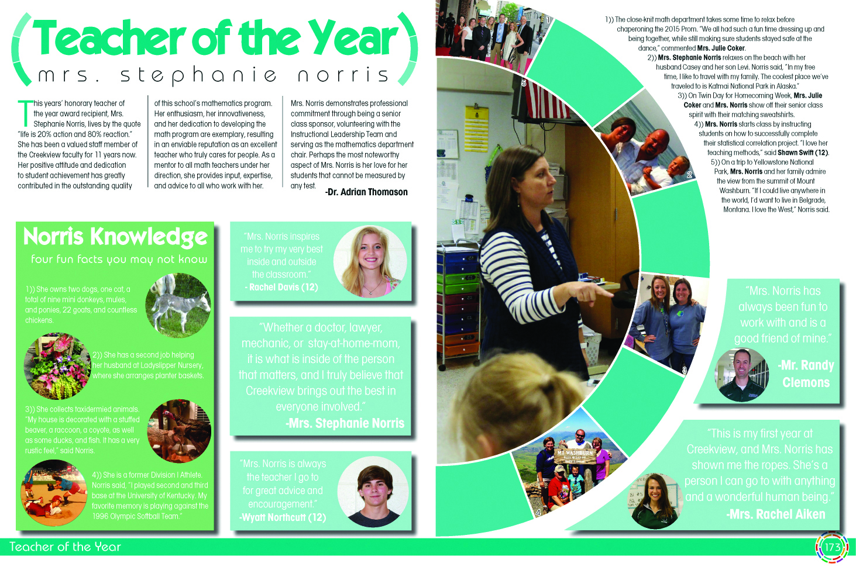
Theme-related color folio bars

Slide 18
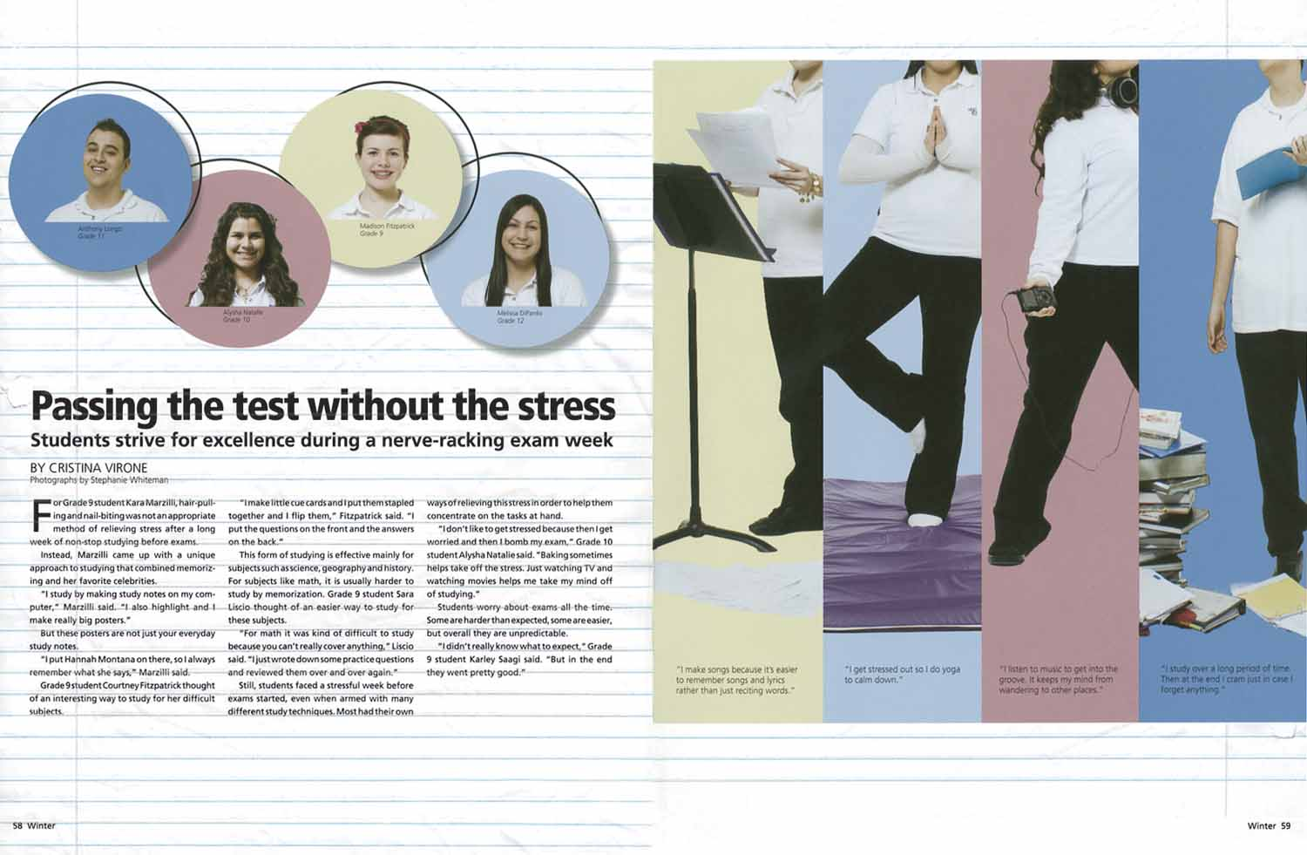
Color used to unify content & add personality

Slide 19
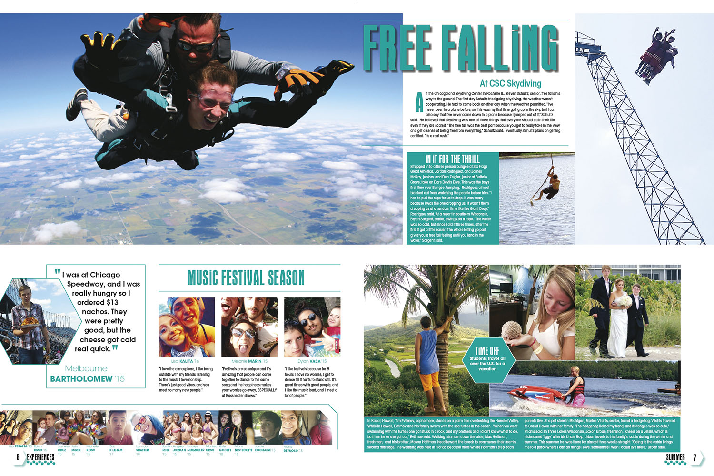
Color coded folios to show the changing sections.

Slide 20
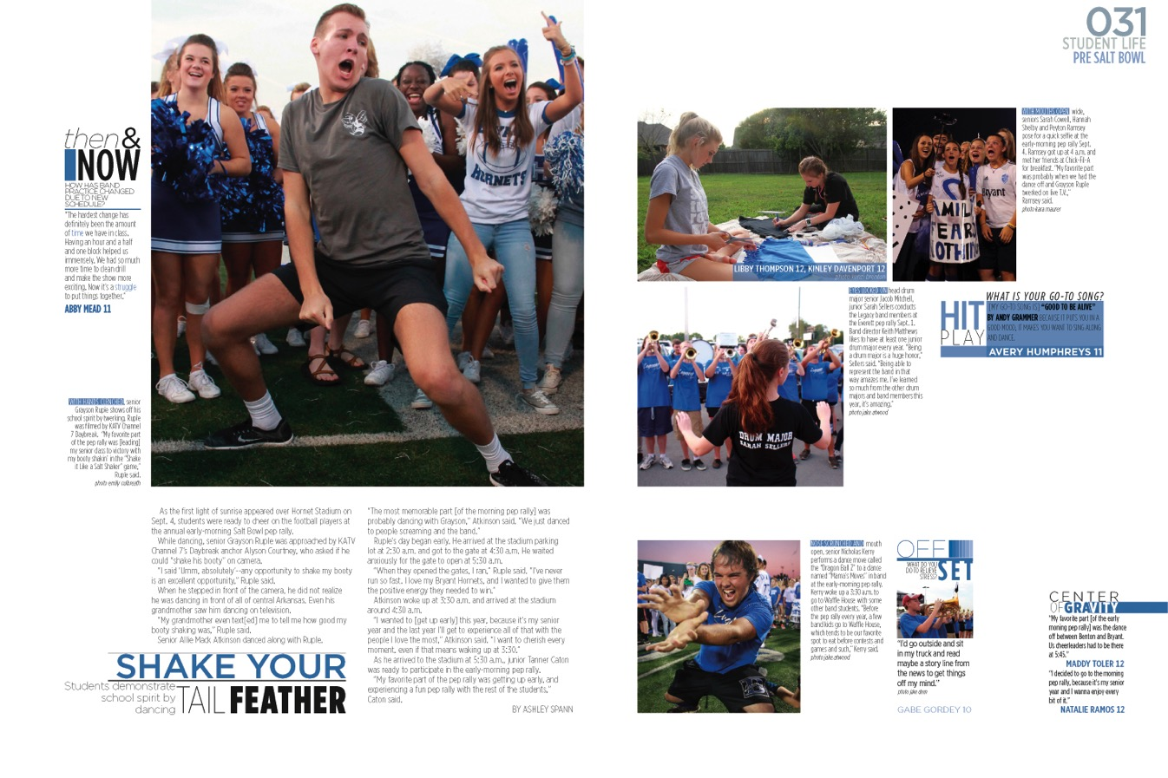
Folios are color coded by section for easy navigation through the book.

Slide 21
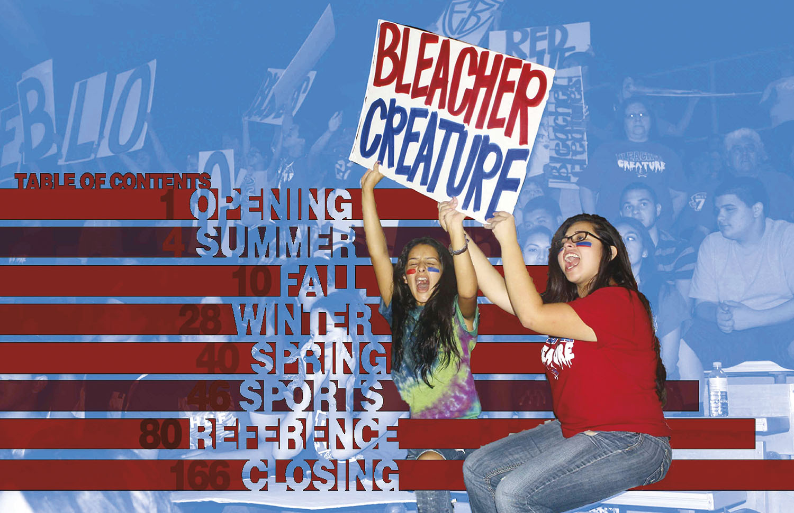
Monochromatic color scheme

Slide 22
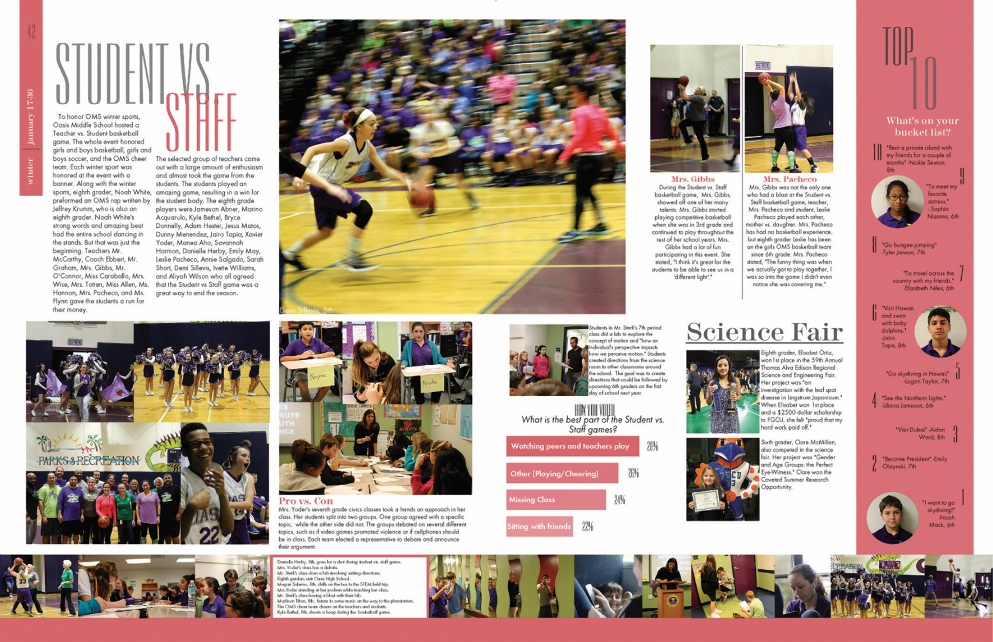
Color blocks are used behind captions and the photo strip to create unity across pages
Color accents the headline and separates content modules.

Slide 23
Echoing color from photos

Slide 24
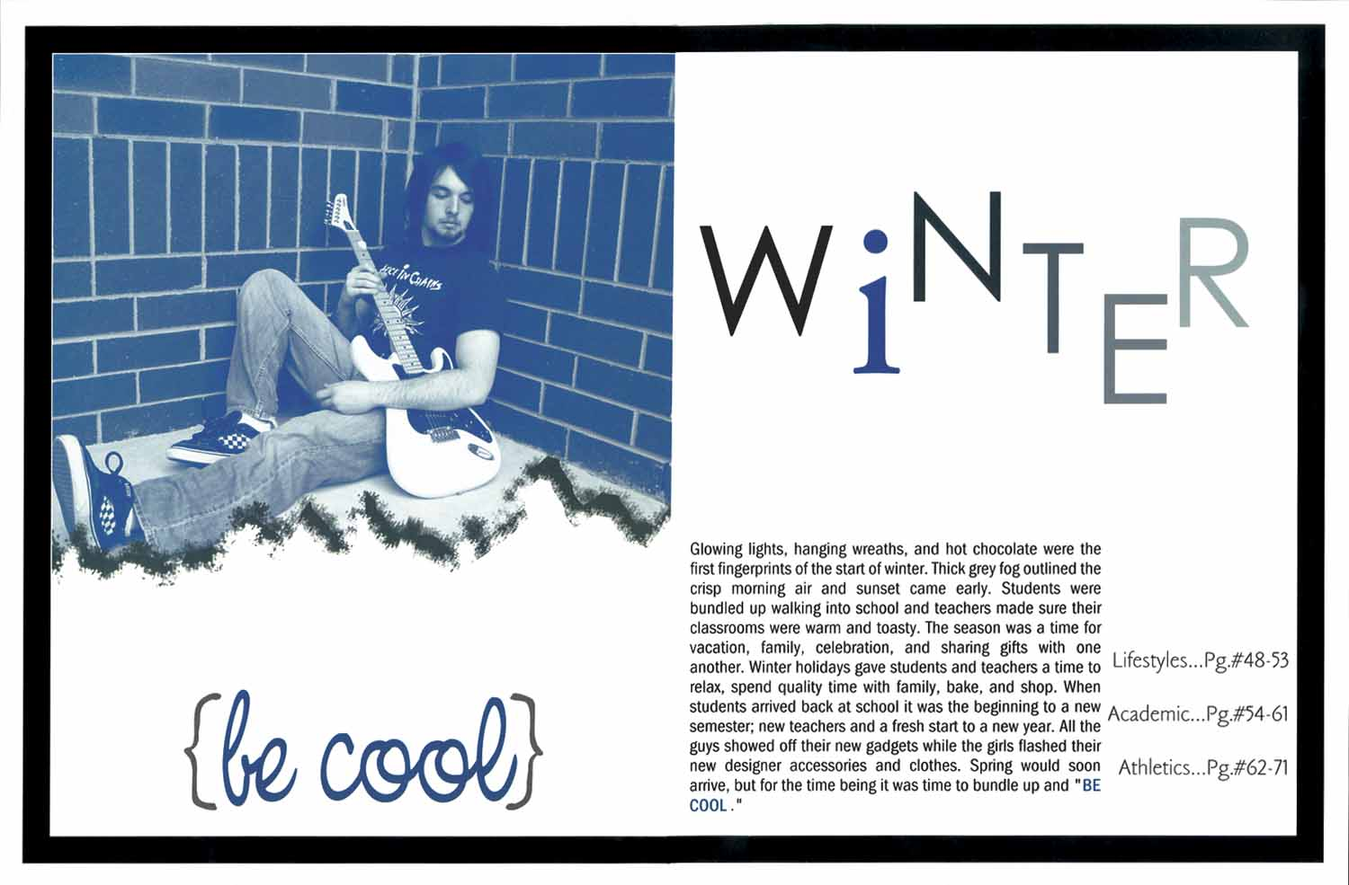
Use duotones to create mood.

Slide 25
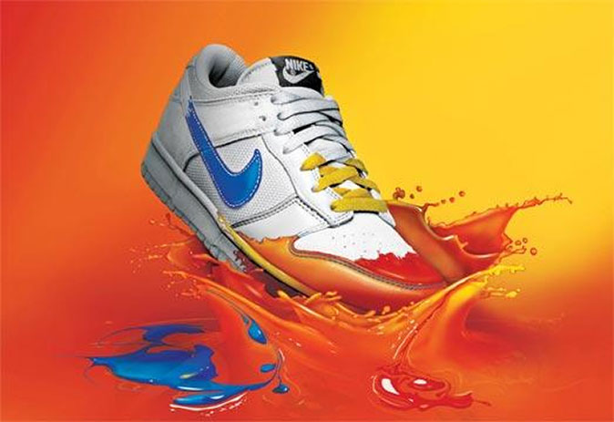
Professional Examples
Color echo links the logo to the paint.

Slide 26
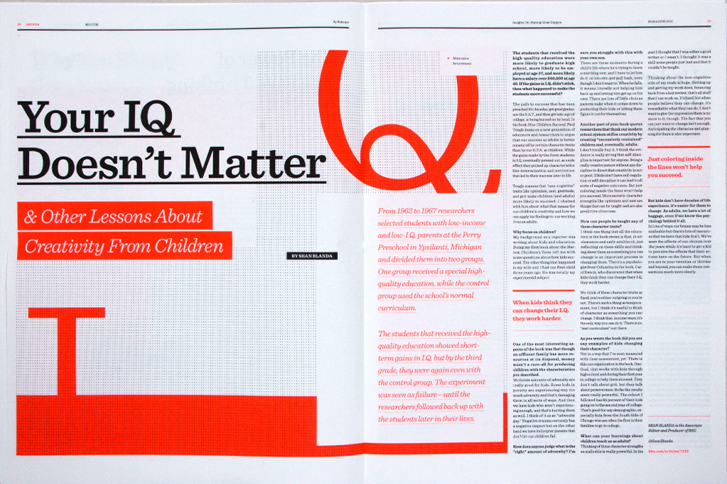
Professional Examples
Repeating orange unifies the spread

Slide 27
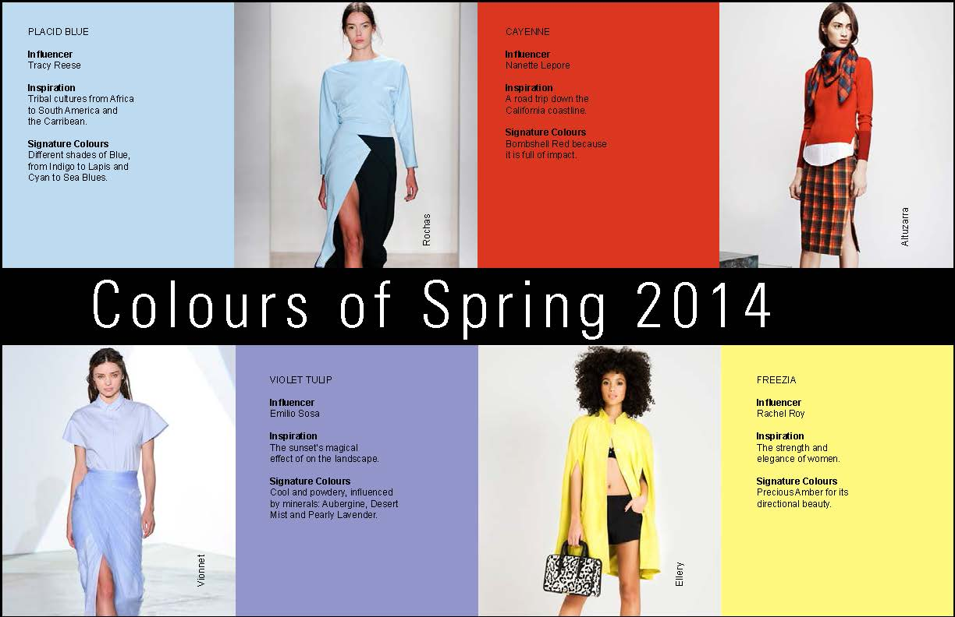
Professional Examples
Color defines content modules

Slide 28
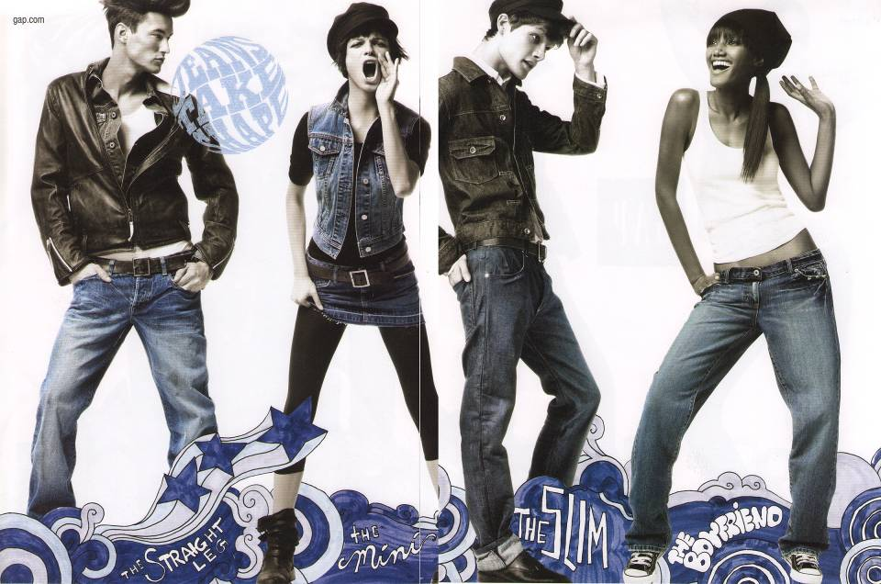
Professional Examples
Artistic use of color accents content.

Slide 29
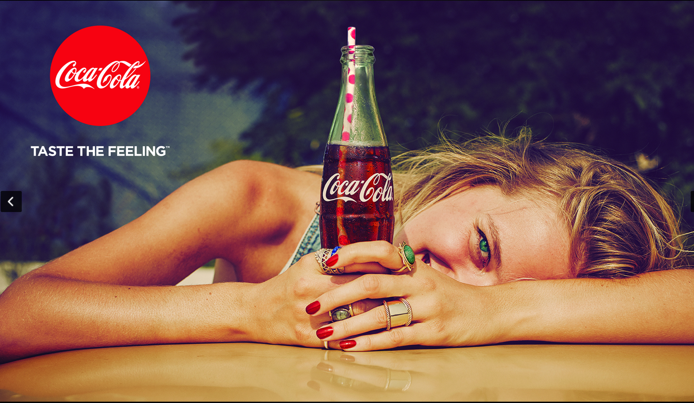
Professional Examples
Color visually links the text and the image

